Slide 1
Revolutionary War
Major battles of the war
Major people
Major ideas
Written by: Greg Clevenger

Slide 2
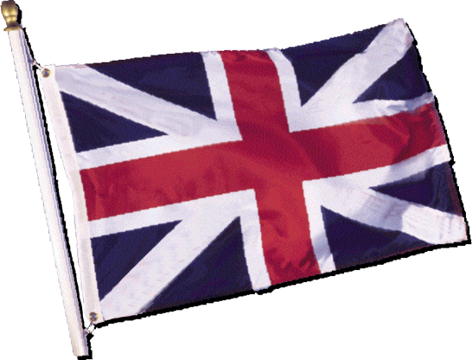
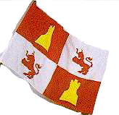
The Story Thus Far
European nations were competing with each other for:
World resources
Military strength
Political superiority
Some nations were upsetting the balance of power
Notes:
European nations were squabbling to see who could be the “Big Kahuna” or the “Top Dog.” They were especially competing with each other for world resources, military strength, and political superiority. Some nations were upsetting the balance of power.

Slide 3
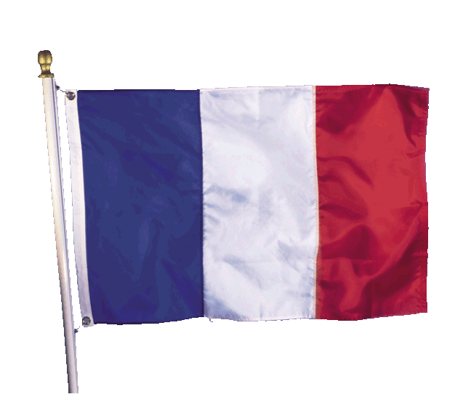
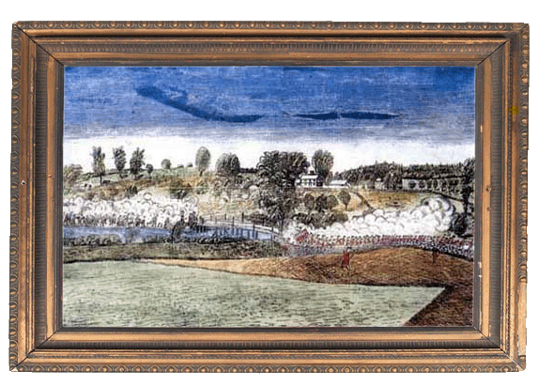
Overview
Also called War for Independence
Started in 1775 in Lexington and Concord Massachusetts
Caused America to separate from Great Britain
Ended in 1783
Notes:
Meanwhile in America, colonists had some ideas of their own. They were ready to leave their parent country and start fresh. The American Revolution, also called the War of Independence, started in 1775. The first shots were fired in Massachusetts in Concord and Lexington. It caused America to separate from Great Britain and thus helped create a new nation. The War was fought for eight years and ended in 1783.

Slide 4
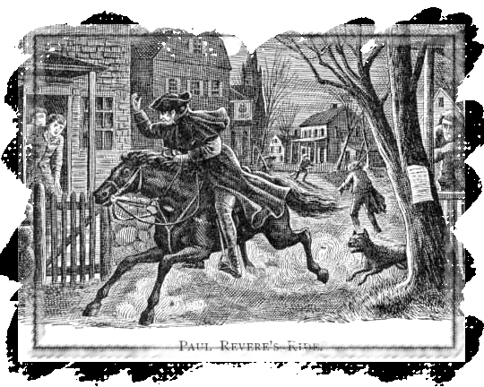
“The Shot Heard Round the World”
American colonists stockpiled weapons in Concord, Massachusetts
800 British troops marched through Lexington on the way to Concord
Paul Revere: “The British are coming!”
Notes:
Enough was enough, American colonists stockpiled weapons in Concord, Massachusetts, outside Boston. Then fighting began. The first battles occurred outside Boston, in Lexington and Concord. It is often called “The Shot Heard Around the World” as 13 colonies decided to challenge the mighty British Empire. Paul Revere, one of the Sons of Liberty, warned colonists, “The British are coming!”

Slide 5
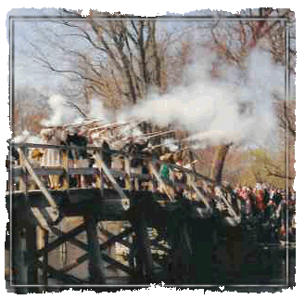
The Armed Militia
Known as “Minutemen”
70 Minutemen on the Village Green
Known as the Battle of Lexington and Concord
Uncertain which side fired first
50 Americans killed and 45 wounded or missing
65 British killed and 208 wounded or missing
Notes:
This was truly a mismatched battle from the start, but the outcome was monumental. Farmers and shopkeepers responded to Paul Revere’s call to arms by being ready to fight at “a minute’s notice,” earning them the nickname “Minutemen.” Seventy Minutemen were waiting for the British soldiers at the Village Green, on April 19, 1775. Historians are still uncertain about which side fired the first shot. Approximately 50 American colonists were killed and 45 were wounded or missing; the British, on the other hand, lost approximately 65 soldiers and 208 were wounded or missing. The battle was a humiliating defeat for the British, who had more organized, highly trained militias. However, they didn’t use guerilla warfare as the Minutemen chose to do and thus the British were unprepared for ambushes and easily slaughtered.

Slide 6
Lexington and Concord

Slide 7
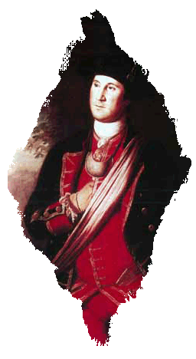
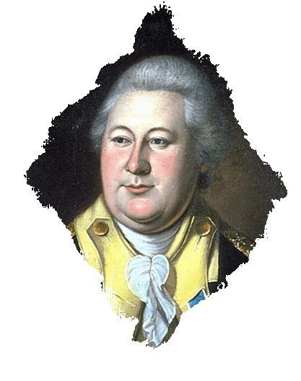
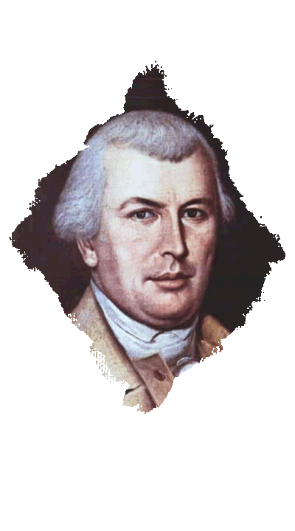
Military Leaders—American
George Washington: Commander of Americans Forces
Nathanael Greene: Top Strategist
Henry Knox: Artillery Expert
Benedict Arnold: Commander under Washington
Notes:
George Washington wasn’t a one-man band. He was assisted by other American military leaders, including top strategist Nathanael Greene and artillery expert Henry Knox, both of whom excelled at a variety of military tasks.

Slide 8
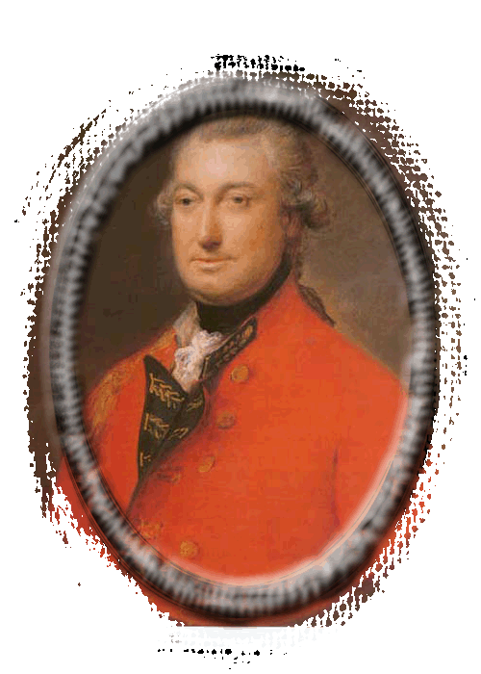
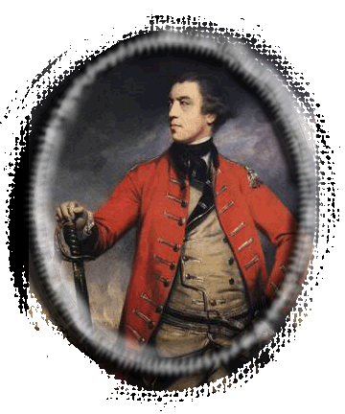
British Leaders
General Charles Cornwallis
General John Burgoyne
Benedict Arnold
William Howe
All considered America one of the worst places to serve
Notes:
The English didn’t exactly find America an ideal vacation spot to hold a war. Great Britain’s military leaders, such as General Charles Cornwallis and General John Burgoyne often considered America one of the least desirable places to serve. The dense forests and seasonally extreme heat offered major obstacles to traditional warfare.

Slide 9
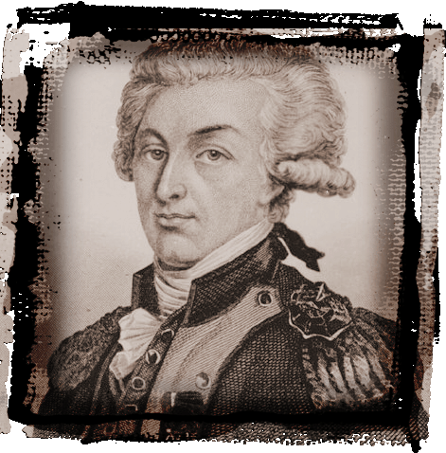
Other Key Players
France, Spain, Germany and Poland
Hessian mercenaries from
Germany
The Marquis de Lafayette: Frenchman who supported American cause
Huge percentage of American gunpowder came from France
Marquis de Lafayette
Notes:
Some historians refer to the American Revolution as a “World War,” because other countries participated in the American Revolution including France, Spain, Germany, and Poland. The leaders of each country either had already claimed part of America or wanted some of the land for themselves. The French, especially, were instrumental in helping the American Army win the War because they had settled parts of the country in the South over a century before the English settlers arrived in the East. The Marquis de Lafayette was a Frenchman who supported the American cause and was a major leading hero of the Revolution. Also, a huge percentage of American gunpowder came from France.

Slide 10
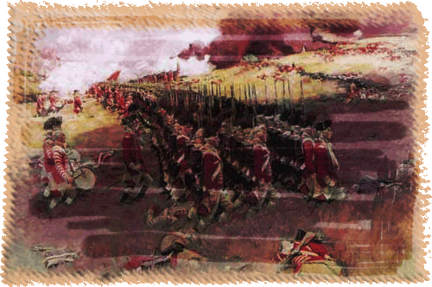
Battle of Bunker Hill - 1775
Bunker Hill located near Boston
Red Coats victorious in third charge
Americans ran out of ammunition
Moral victory for American Army
Notes:
Another important battle was one that the Americans lost, yet they felt triumphant. The Battle of Bunker Hill, actually fought on Breed’s Hill just outside of Boston in June 1775, inspired the Americans to believe fully that they could stand up to the British Army. Although about 1,400 Army of New England soldiers occupied the defenses, and 2,500 Red Coats unsuccessfully charged the hill numerous times, the Red Coats defeated the American soldiers in the third charge only because the Americans ran out of ammunition. The Americans lost the Battle of Bunker Hill, but considered the battle a moral victory.

Slide 11
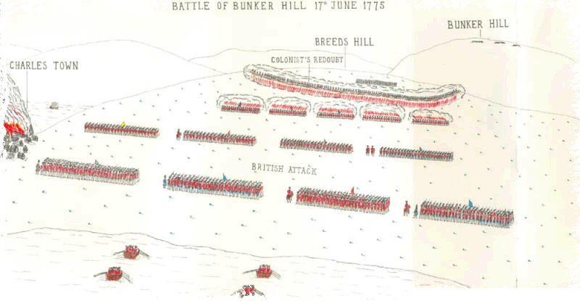
Bunker Hill
Costliest battle for British during whole war
British casualties 1,054
American casualties 441
British began to get nervous
Washington took command of the army two weeks after this battle
Notes:
The Battle of Bunker Hill was the costliest battle for the British in the eight-year war. British casualties numbered 1,054, while American casualties were 441. At this point, the British Empire realized they faced a full-scale war with the Americans. Two weeks after this battle, Washington took command of the American Army.

Slide 12
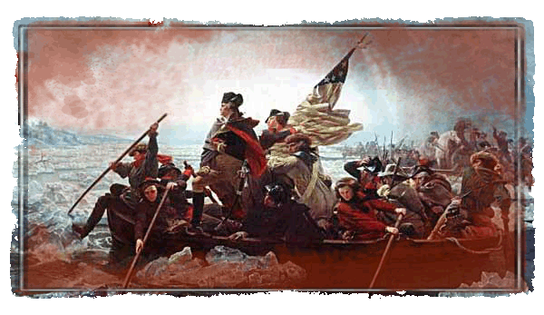
Battle of Trenton—1776
Surprise attack the day after Christmas
Washington crossed the Delaware
Approximately 1000 German soldiers fighting for the British captured
Notes:
The third significant battle called the Battle of Trenton was a surprise attack by General Washington. Washington and his men crossed the Delaware on Christmas night 1776. They caught trained German soldiers, known as Hessians, napping early the next morning. Washington’s brilliant strategy led to a great American victory.

Slide 13
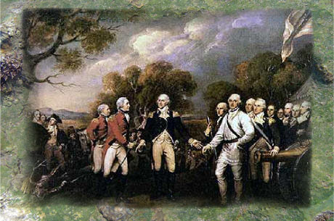
Battle of Saratoga – 1777
The turning point of the war
The biggest American victory at the time
Approximately 5,000 British surrender to Washington
Notes:
A major turning point of the war occurred as a result of the Battle of Saratoga in October 1777. It was the biggest American victory at the time. British General Burgoyne surrendered to American General Horatio Gates.

Slide 14
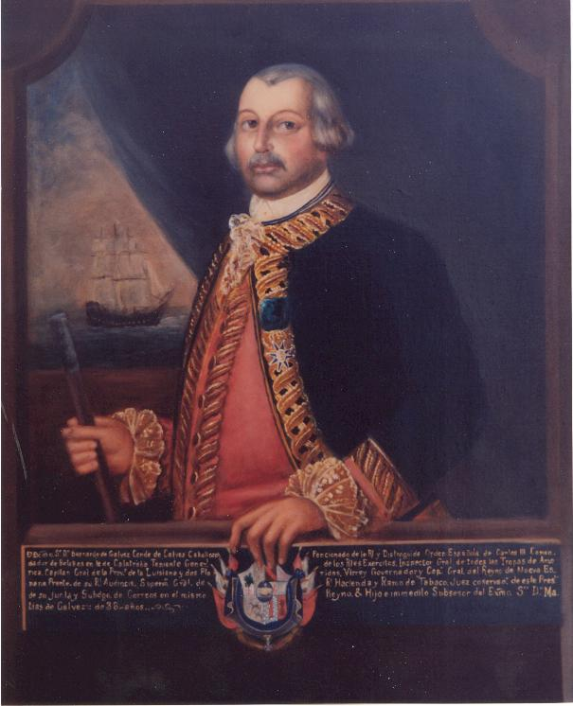
Battle of Saratoga – 1777
After the American victory France changed its policies.
Feb. 1778 France and American formed an alliance
France declared war on Britain the next month
Spain declared war in 1779
Bernardo de Galvez chased British troops out of Louisiana and Florida.

Slide 15
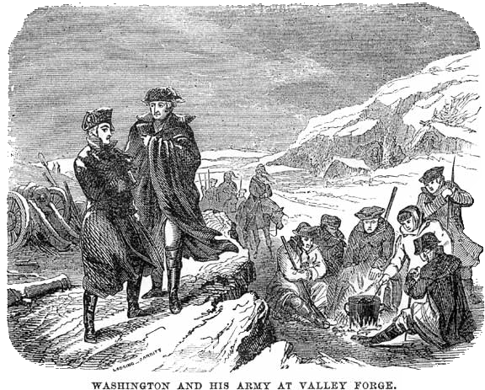
Valley Forge – 1777-1778
American Army out of food and clothing
Valley Forge briefly a refuge
Supplies ran out and many died
Washington appeals to Congress for help
Low point for American Army
Any deserters are shot
Notes:
Valley Forge, Pennsylvania, saw the Americans in a battle not against the British but rather against nature. The winter of 1777-1778 was a time for Americans to regroup, re-supply, and train. The American Army had run out of food and clothing, and Washington had to appeal to Congress for help because supplies were quickly used up at Valley Forge. Also, the bitter cold added to the deaths of many exhausted, wounded, maimed, malnourished, and dispirited soldiers. The American Army reached a low point during this time.

Slide 16
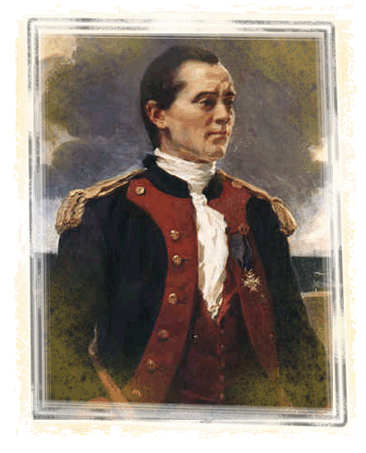
Battle of Yorktown—1781
French blockade aided this final battle
Escape for the British was impossible
British General Cornwallis faced American forces approximately twice his size
John Paul Jones
Notes:
The end was in sight with the Battle of Yorktown. The Americans were aided by a French blockade making British escape impossible. British General Cornwallis faced American forces approximately twice his size and no where to go.

Slide 17
Yorktown

Slide 18
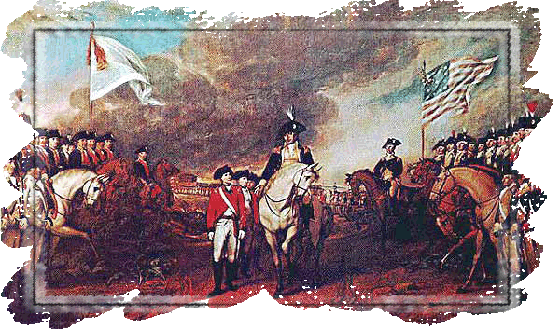
Yorktown
Approximately 8,700 British troops surrendered
Pinned in by American and French Naval fleets
General Benjamin Lincoln accepted the surrender sword
British bands played “The World has Turned Upside Down”
Notes:
The last campaign of the Revolution took place in the south at Yorktown, Virginia, in 1781. About 8,700 British troops surrendered when the Americans and the French naval fleet pinned in the British in a series of brilliant strategic maneuvers. General Benjamin Lincoln accepted the surrender sword from a Cornwallis aide. The British bands played “The World Turned Upside Down.”

Slide 19
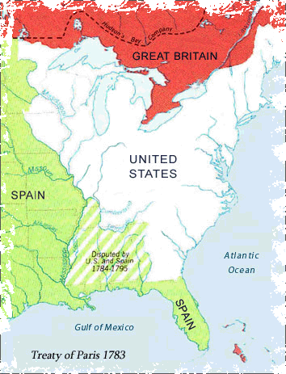
The Treaty of Paris—1783
Officially ended the American Revolution
Set many geographic borders, including U.S. and Canada
Florida was returned to Spain
British merchants must be paid for lost items
Loyalists must be paid for lost property
Notes:
The official end to the war came two years after Yorktown at the Treaty of Paris. The British commander, Cornwallis, was so humiliated by the defeat that he refused to meet with Washington for the formal surrender and sent an aide instead. The treaty set many geographic borders including that of the United States and Canada. Canada went to the British, but later the French won part of the country. Florida was returned to Spain.

